Slide 1
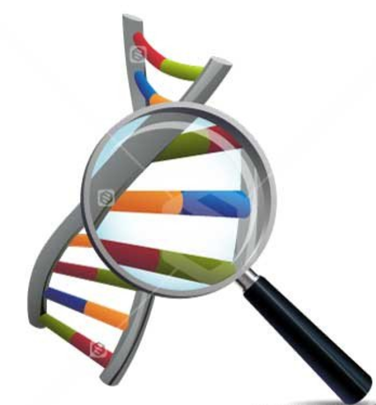

Evidence for Evolution
Comparative Studies in Biochemistry
DNA

Slide 2

Overview
Idea of evolution and evidence for it accepted by vast majority of scientists
Has been controversial for reasons unrelated to the scientific evidence
Important to look at evidence to support scientific theory
Recent advances in technology provide further evidence to support the theory of evolution

Slide 3
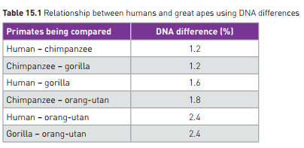
Comparative Studies in Biochemistry - DNA
DNA
  uses sequences of 4 nitrogenous bases
  Codes for protein production
  All living things use the same 4 bases, the same DNA code
  Sequence of bases varies
    Mutation
    Natural selection
    Genetic Drift
  As living things reproduce, code differs over generations between offspring, despite common ancestor, but some stays the same.
    More distantly related: greater variation
    Closely related: more shared

Slide 4
Comparative Studies in Biochemistry - DNA
Chromosomes also contain sequences of bases that don’t appear to code for anything:
  “junk DNA”
  Also vary across generations
  Can also be compared for similarities and differences to assess relatedness.
Example: Endogenous retroviruses (ERV)
  Viral sequence that has become part of the organism’s genome in the germline cells
  Passed on to each new generation
  Make up 8% of human genome
  Other primates have some of the same sequences in the same locations, indicating that we, and they, are descended from a common ancestor who was originally infected with the virus.

Slide 5
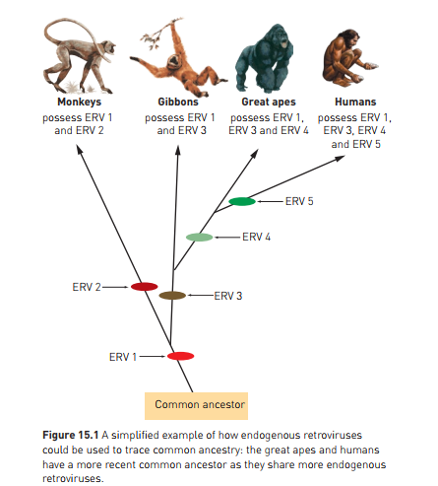

Slide 6
Comparative Studies in Biochemistry - DNA
PCR can be used to amplify tiny amounts of DNA
  Facilitates sequencing
  Allows small amounts of DNA from fossil record to be analysed
Electrophoresis
  Also used to create profile and compare
Bacterial enzymes (restriction enzymes)
  Used to cut up DNA to sequence it.
** Processes discussed in Ch 13 are a key part of sequencing DNA for analysis of relatedness between species

